Slide 1
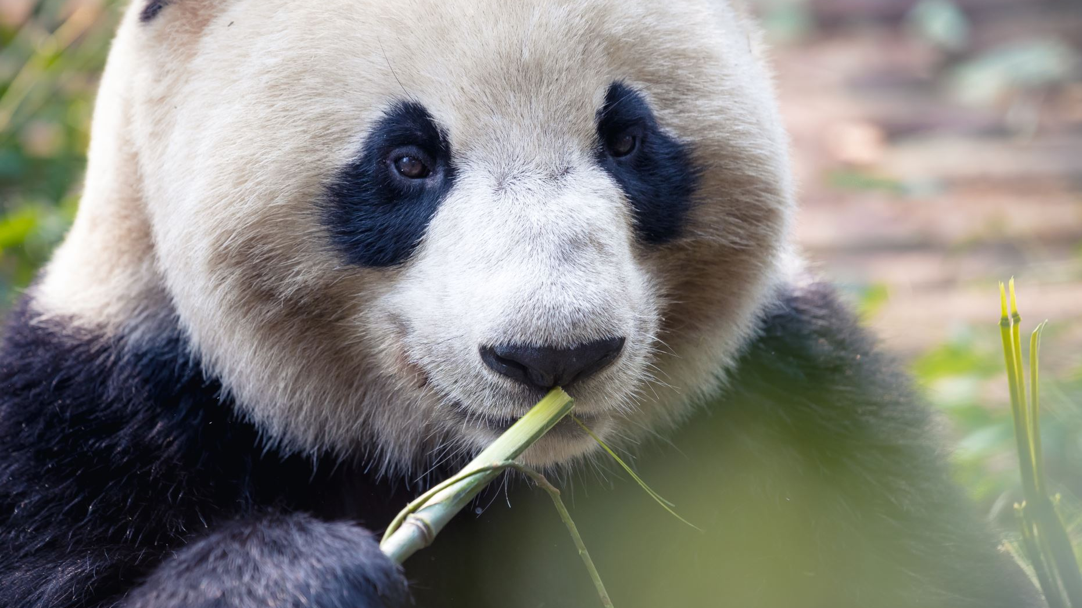
Giant Pandas
By: Sophia Naqvi

Slide 2
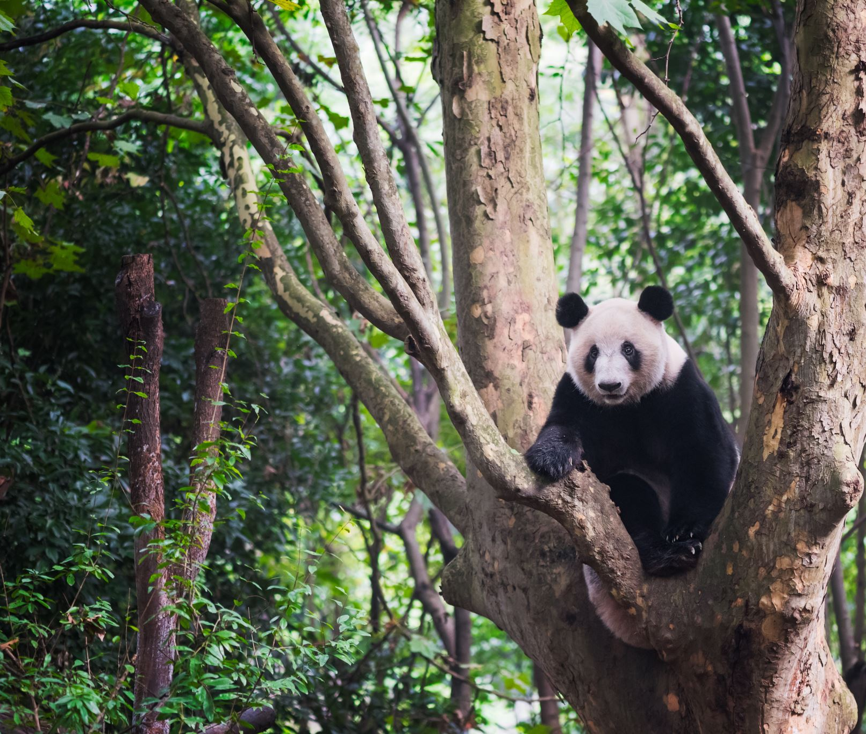
Pandas are black and white. Their fur is very thick.

Slide 3
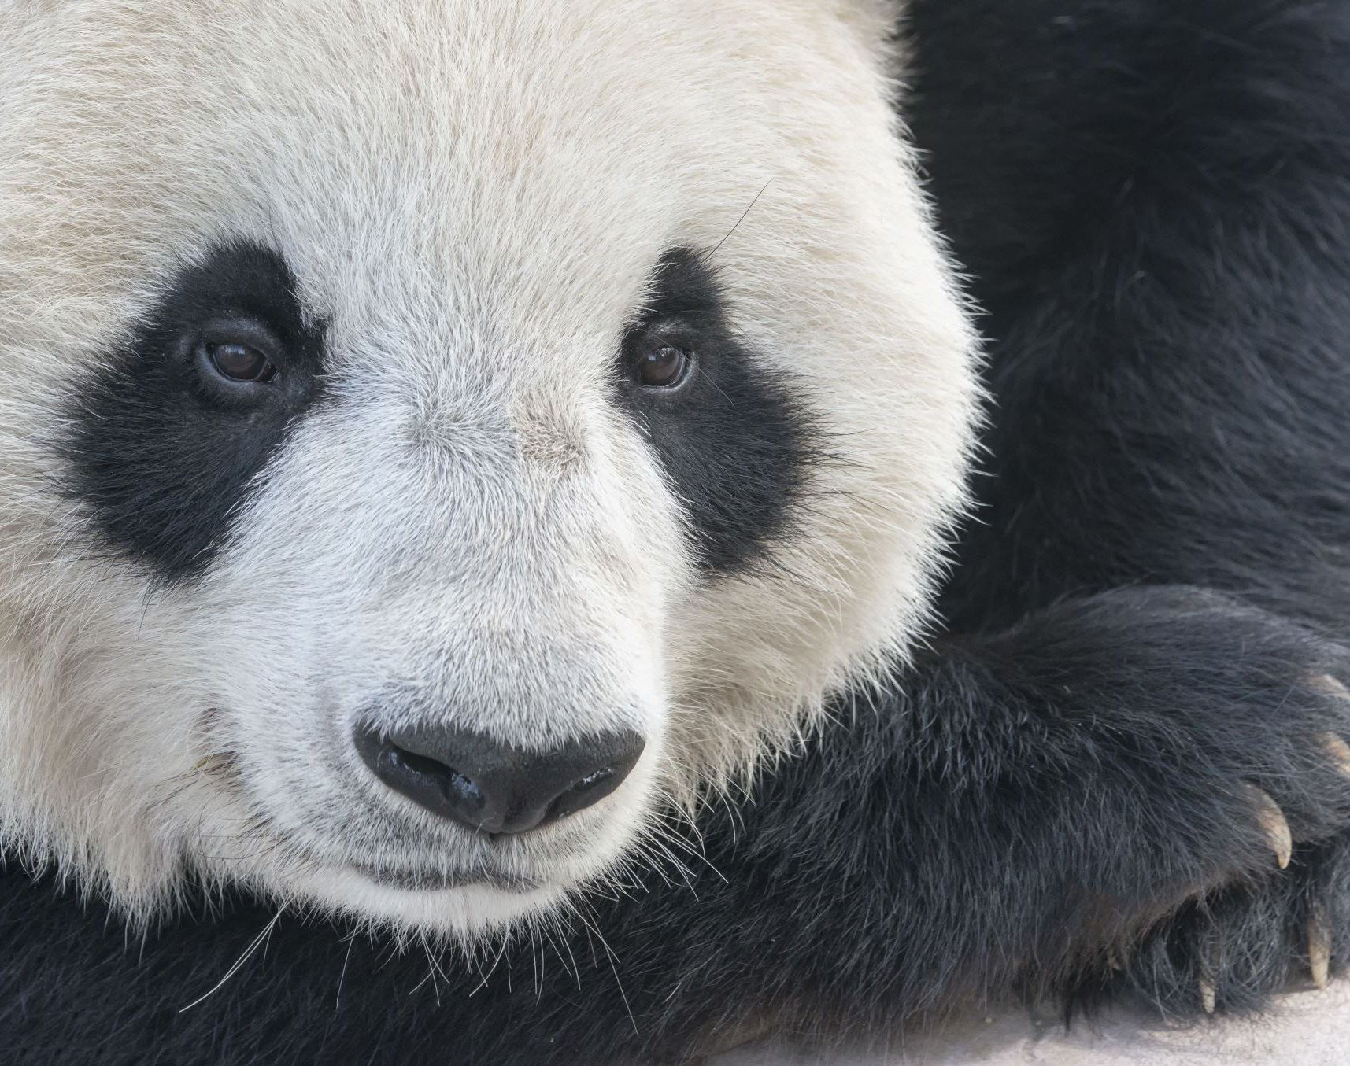
Pandas live in China. There are around 1,600 pandas living in China.

Slide 4
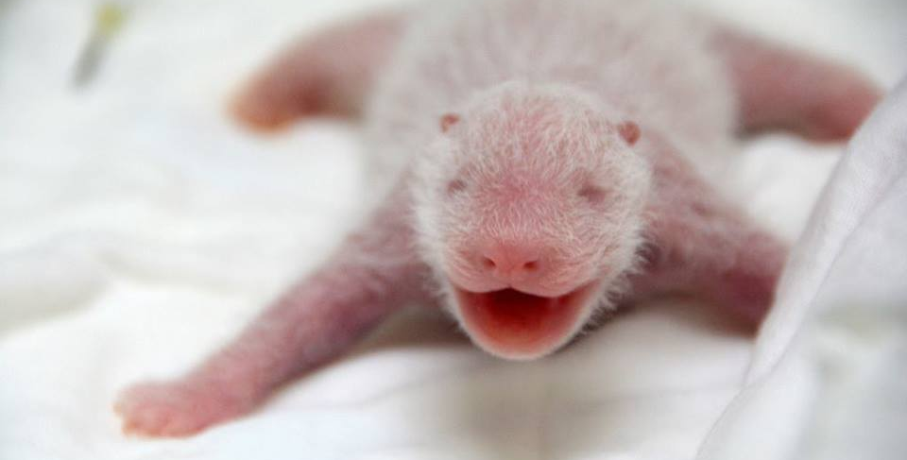
Newborn babies are pink and the size of a stick of butter. They have little bits of white fuzz and they are not able to open their eyes when they are first born.

Slide 5
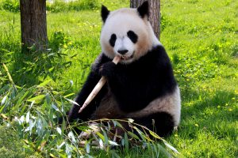
Pandas eat bamboo. They are herbivores. Pandas can eat up to 16 hours a day.

Slide 6
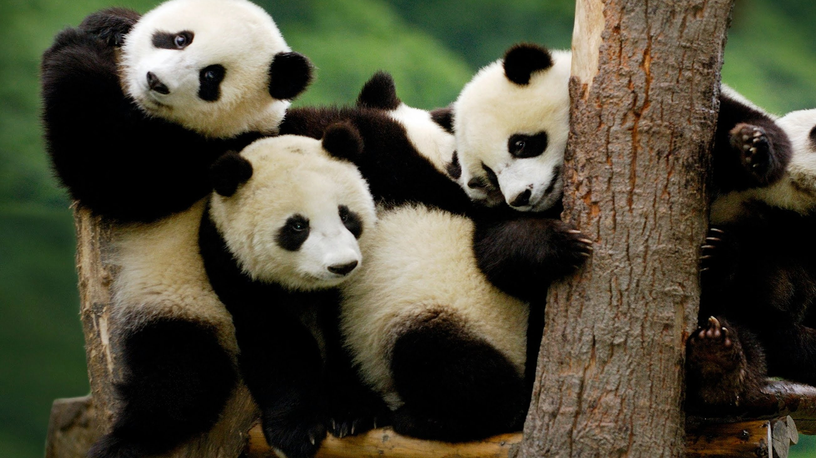
Pandas are mammals, just like humans.
This Photo by Unknown author is licensed under CC BY.

Slide 7
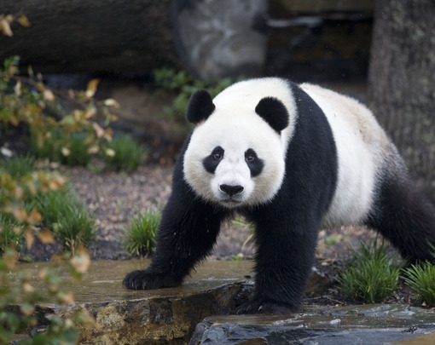
They have sharp teeth and sharp claws.
This Photo by Unknown author is licensed under CC BY-ND.

Slide 8
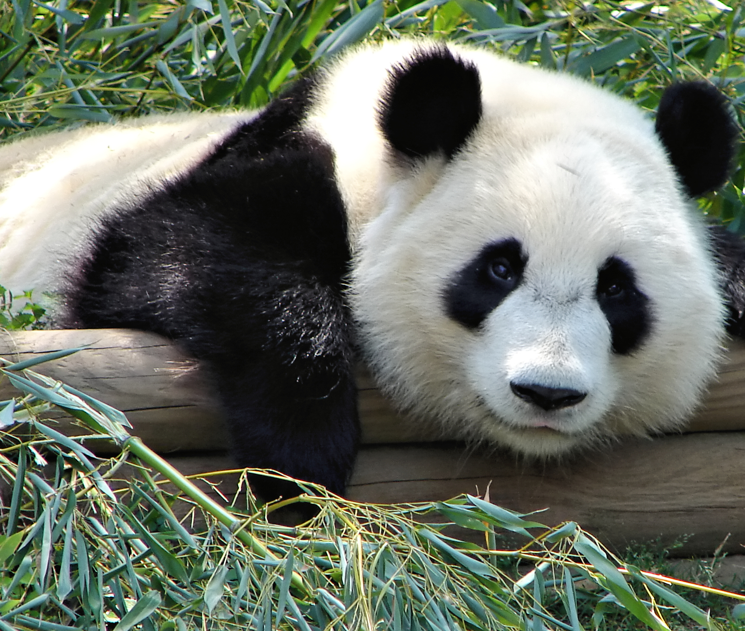
Pandas are so cute! They are as fluffy as a cloud!
This Photo by Unknown author is licensed under CC BY-SA.

